Slide 1
AI & Crypto Currency
A price prediction of Ethereum Using Machine Learning and Deep Learning Methods

Slide 2
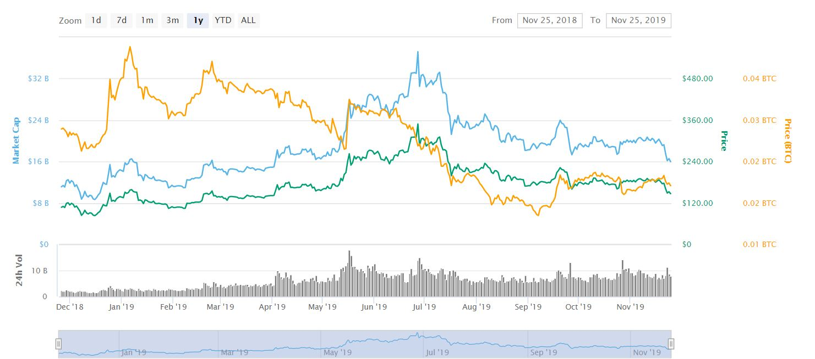

Why Ethereum?
A brief introduction of cypto currency

Slide 3
Data Mining
What I collected for training?

Slide 4

Transaction data
Price – Average, High, Low, Open price per day from 2017/1 to 2019/11
Vol. – The Trading Volume of the Day
Change – The price change according to yesterday in %
Comparison Data - Bitcoin

Slide 5
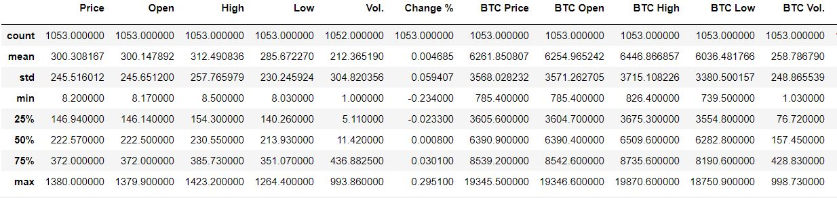
Quick view of Data

Slide 6
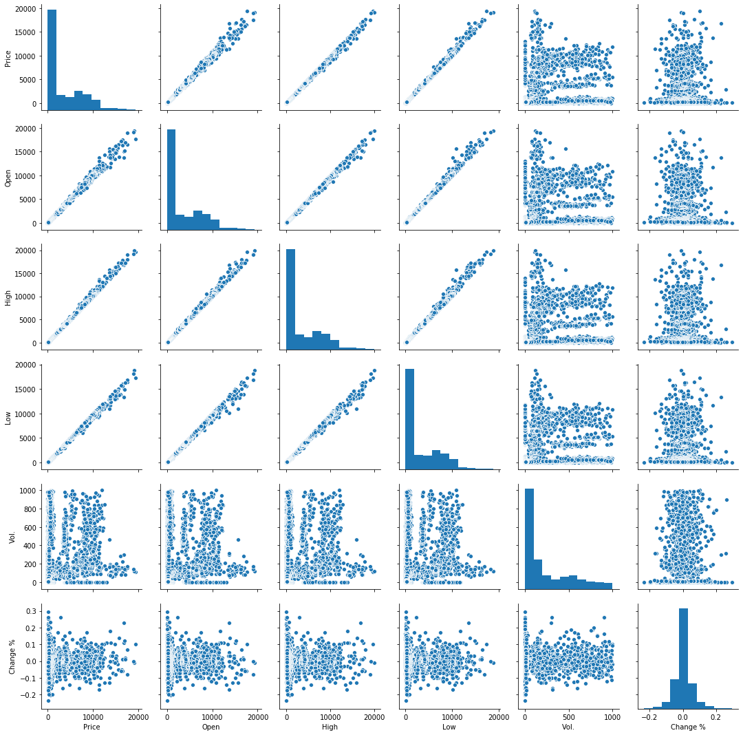
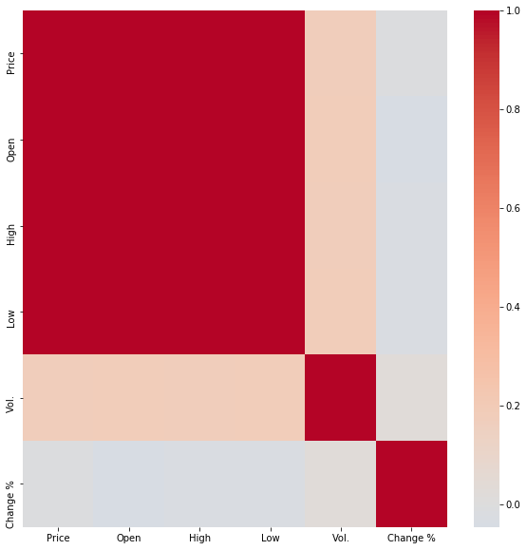
EDA Result

Slide 7
Price Prediction
Machine Learning - Regression

Slide 8

Price Prediction
Using logistic regression

Slide 9
Price Prediction
12/2
12/16
12/9
Final
Build DL model
Collect Recent Data
12/23
Using LSTM
As validation
Improve
Final Present
Adjust the model and check if there’s any other important data
Trade Bot
Try to integrate the result into

Slide 10
Thanks for Listening
Q&A
By. Andrew Yang
Nov. 2019

